Slide 1
DR 4
Team 520
John Baumann, Natalie Boggess, Cody Carlson,
Megan Jadush, Malik Jean-Baptiste, Anders Snell
01/23/2025

Slide 2
Malik Jean Baptiste
Introduction – Project Mentors
Sponsor:
Dr. Rassweiler
Manager:
Dr. McConomy
Advisor:
Dr. Clark

Slide 3
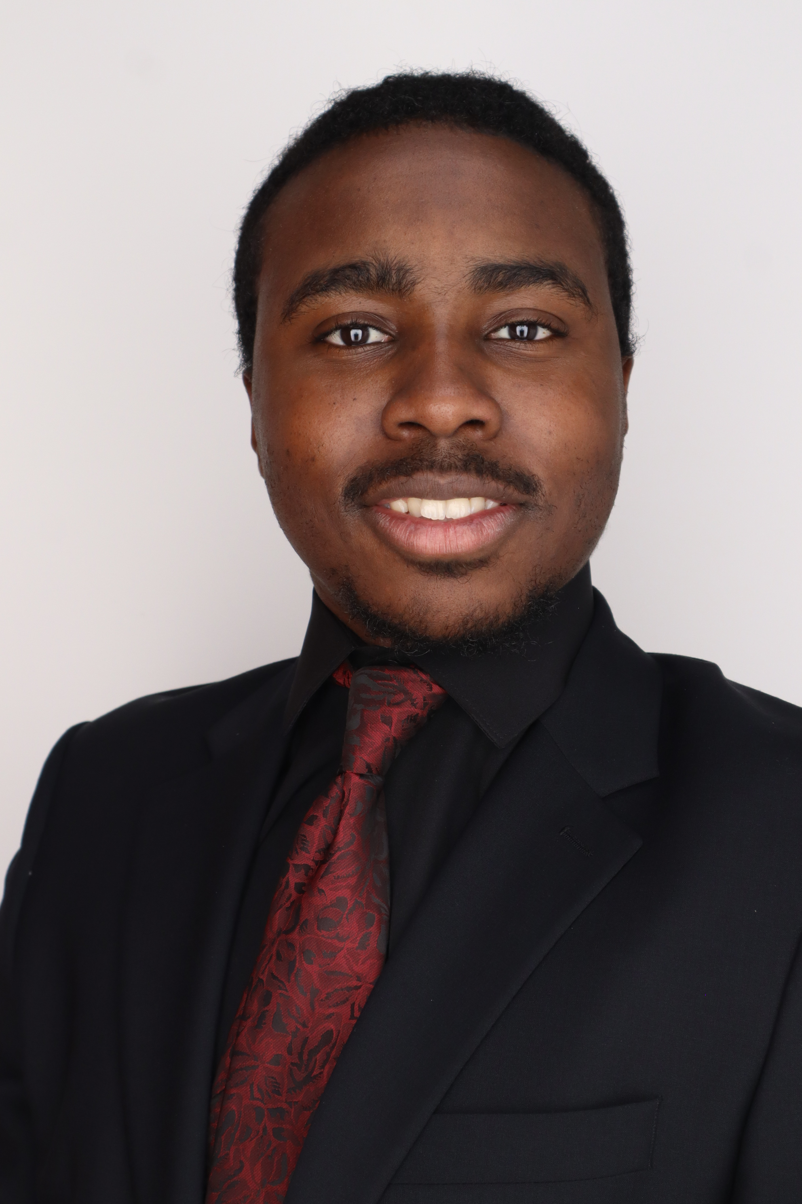
Introduction – Team 520
Malik Jean Baptiste
John Baumann
Design Engineer
Cody Carlson
Software Engineer
Malik Jean-Baptiste
Robotics Engineer
Natalie Boggess
Marine Engineer
Megan Jadush
Materials Engineer
Anders Snell
Mechatronics
Engineer

Slide 4
Project Objective
Malik Jean-Baptiste
The objective of this project is to create a system capable of recording a diver’s position while submerged.

Slide 5
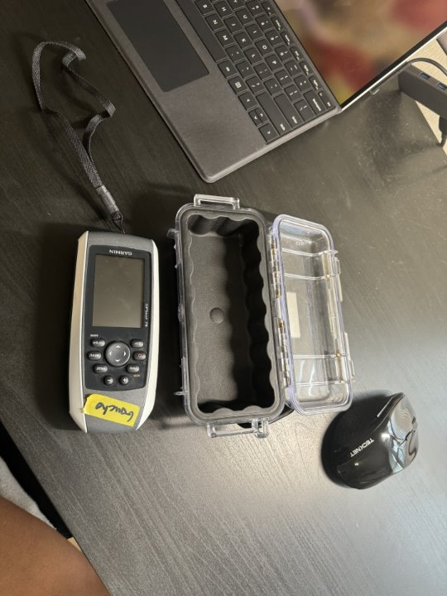
Project Summary
Malik Jean- Baptiste
Dr. Rassweiler SCUBA dives and plots diseased corals on his map
Current system: location is within a 5m radius circle (before standard error), wants to get more precise
Figure 1 : Current Equipment

Slide 6
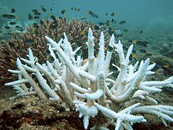
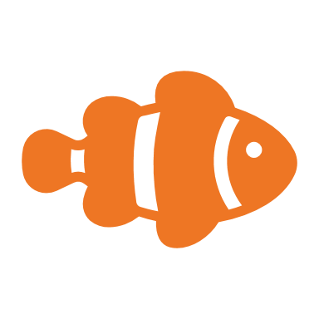
Overview
Malik Jean Baptiste
Error
GPS
Dr. Rassweiler SCUBA dives and plots diseased corals on his map post dive, but the current method is not accurate

Slide 7
Malik Jean Baptiste
Error
GPS

Slide 8
Background
Malik Jean- Baptiste
GPS is incapable of penetrating through water
Relies on radio waves
Buoys will drift due to waves and current
Will be operating at up to 10m underwater
Can approximate a right triangle for diver position
Horizontal distance between diver and surface device is needed

Slide 9
Primary Market
Malik Jean Baptiste
Dr. Rassweiler
Oceanographers

Slide 10
Secondary Market
Malik Jean Baptiste
Commercial Fishing
Underwater Exploration
Recreational Divers
Marine Sanctuary

Slide 11
Assumptions
Malik Jean Baptiste
The user will be within 10 meters of the water's surface.
The user has access to a watch and a waterproof notepad.
The max duration of each dive will be no longer than 90 minutes.
Weather conditions will consist of wind (15-20 knots),
small waves (2-3 feet), and a water temperature of around
82°F.

Slide 12
Stakeholders
Natalie Boggess
Dr. Andrew Rassweiler
Investor, Decision Maker, Receiver
Rassweiler Laboratory
Operator
Dr. Shayne McConomy
Manager
Dr. Jonathan Clark
Expert
RL

Slide 13
Customer Needs
Natalie Boggess
The device still operates normally when experiencing high winds.
The device is easy to carry straight from the shore into the ocean.
The device can log a digital location.
The device can operate with the user down to 10m.
The device’s battery lasts for at least 90 minutes.
The device can get a more precise reading of the diver’s location.
The device consists of 1 or 2 small pieces.
The device can be packed into a carry-on bag.

Slide 14
Functional Decomposition
Natalie Boggess
Underwater Tracking System
Sensor
Power Source
Structures
Data

Slide 15
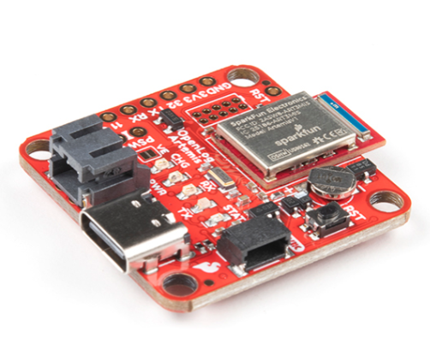
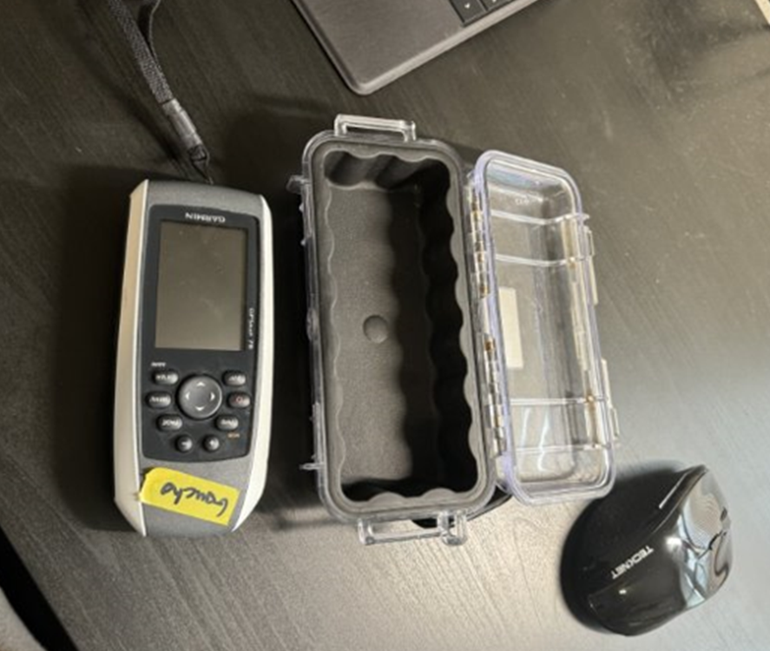
Inertial Navigation System (INS)
Natalie Boggess
Inertial Measurement Unit (IMU)
Attitude and Heading Reference System (AHRS)
Picture of INS goes here
Picture of INS goes here
Global Positioning System (GPS)
Global Positioning System (GPS)
Attitude and Heading Reference System (AHRS)
Linear accelerations and angular velocities are measured with accelerometers and gyroscopes
Orientation is determined with data from the IMU and a
magnetometer, ran through filter algorithms
Orientation is determined with data from the IMU and a
magnetometer, ran through filter algorithms
Positioning data from satellites used to correct cumulative positional errors (drift) of the system
Positioning data from satellites used to correct cumulative positional errors (drift) of the system
Figure 3: IMU + AHRS
Figure 4: GPS
20

Slide 16
Key Goals
Natalie Boggess
The system will be able to reliably work at a depth underwater up to 10 meters
Pinpoint diver's position within 6 m. diameter
The system will be portable, capable of launching from the shore, and require minimal setup

Slide 17
Targets
Natalie Boggess
Sensors
Tracks diver global position (6 m.)
Power Sources
Lasts ≥ 90 minutes
Structures
Waterproof
Transportable
Data
Transmission (9600 baud)
Storage (32 GB)

Slide 18
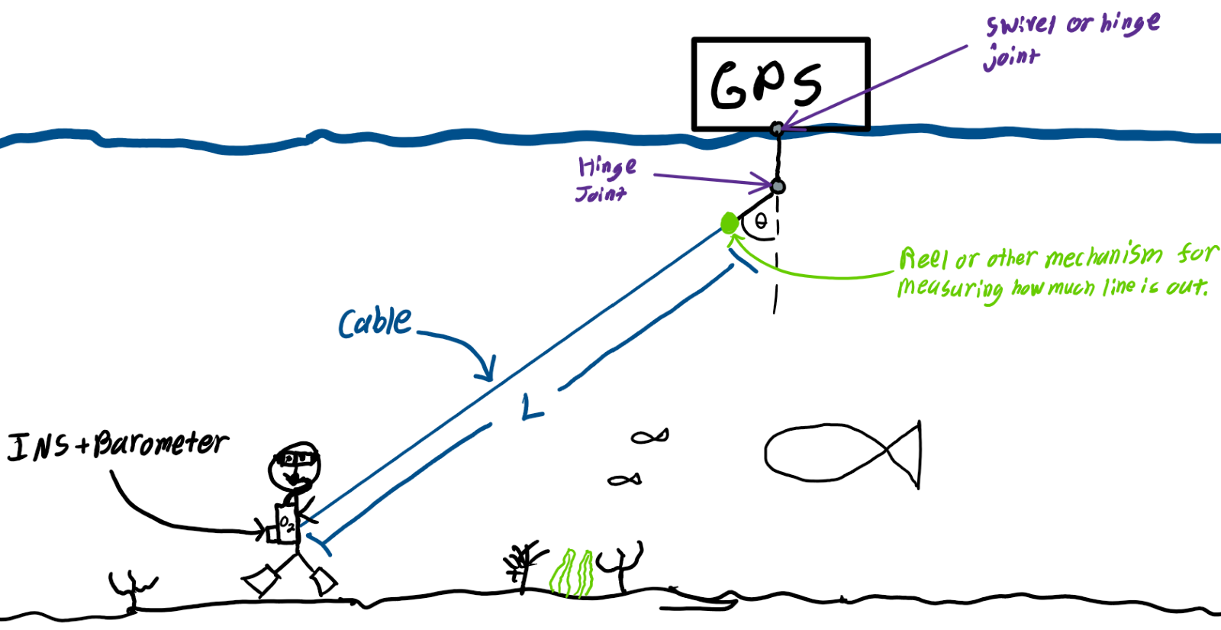
First High Fidelity Concept #33
Natalie Boggess
Inertial Navigation System (INS)
Barometer
Angle sensor
GPS
Cable instead of rope
Measurement of cable length

Slide 19
Second High Fidelity Concept #55
Natalie Boggess
Long range radio communication (LoRa) triangular positioning technology
Two nodes on shore and one on the ocean
Attitude & heading reference system (AHRS)
Angle sensors

Slide 20
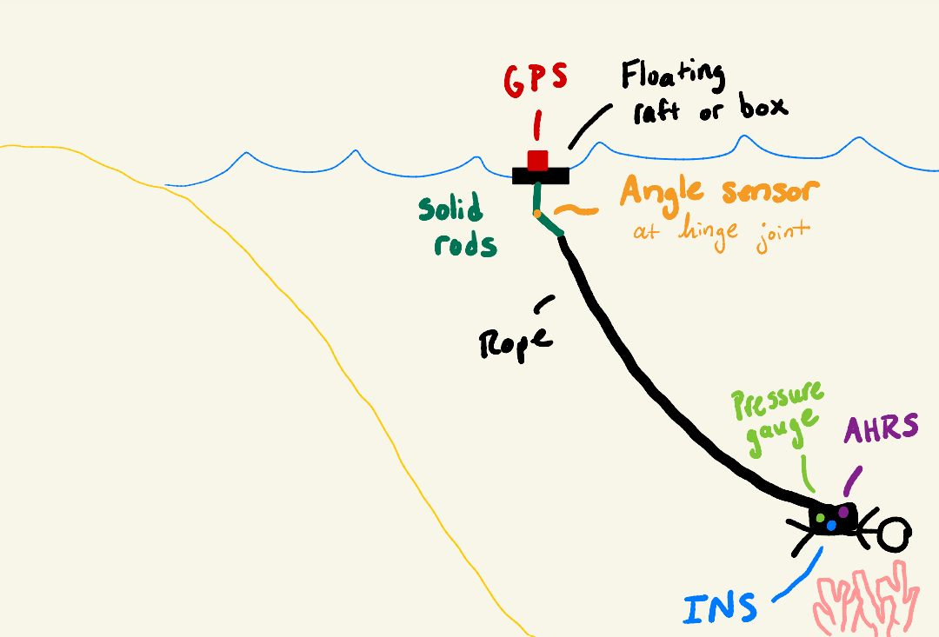
Third High Fidelity Concept #61
Natalie Boggess
Inertial navigation system (INS)
Angle sensors
Attitude & heading reference system (AHRS)
GPS secured in a floating raft

Slide 21
Final Design: Concept 61
Natalie Boggess

Slide 22
First Prototype
Natalie Boggess

Slide 23
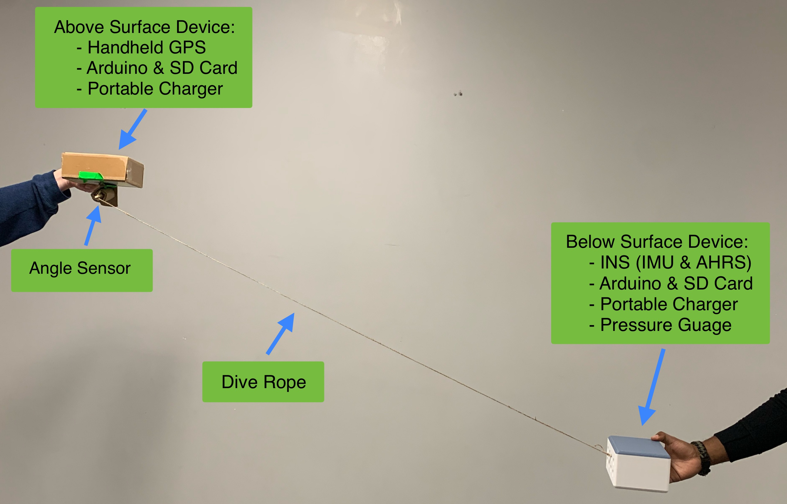
Updated Prototype
Megan Jadush

Slide 24
Project Updates
Megan Jadush
GPS and INS testing completed together
3D Printing and post-processing
Pulled raw data off the INS
Continuous Research
Tested and modified angle sensor setup
Barometer testing completed

Slide 25
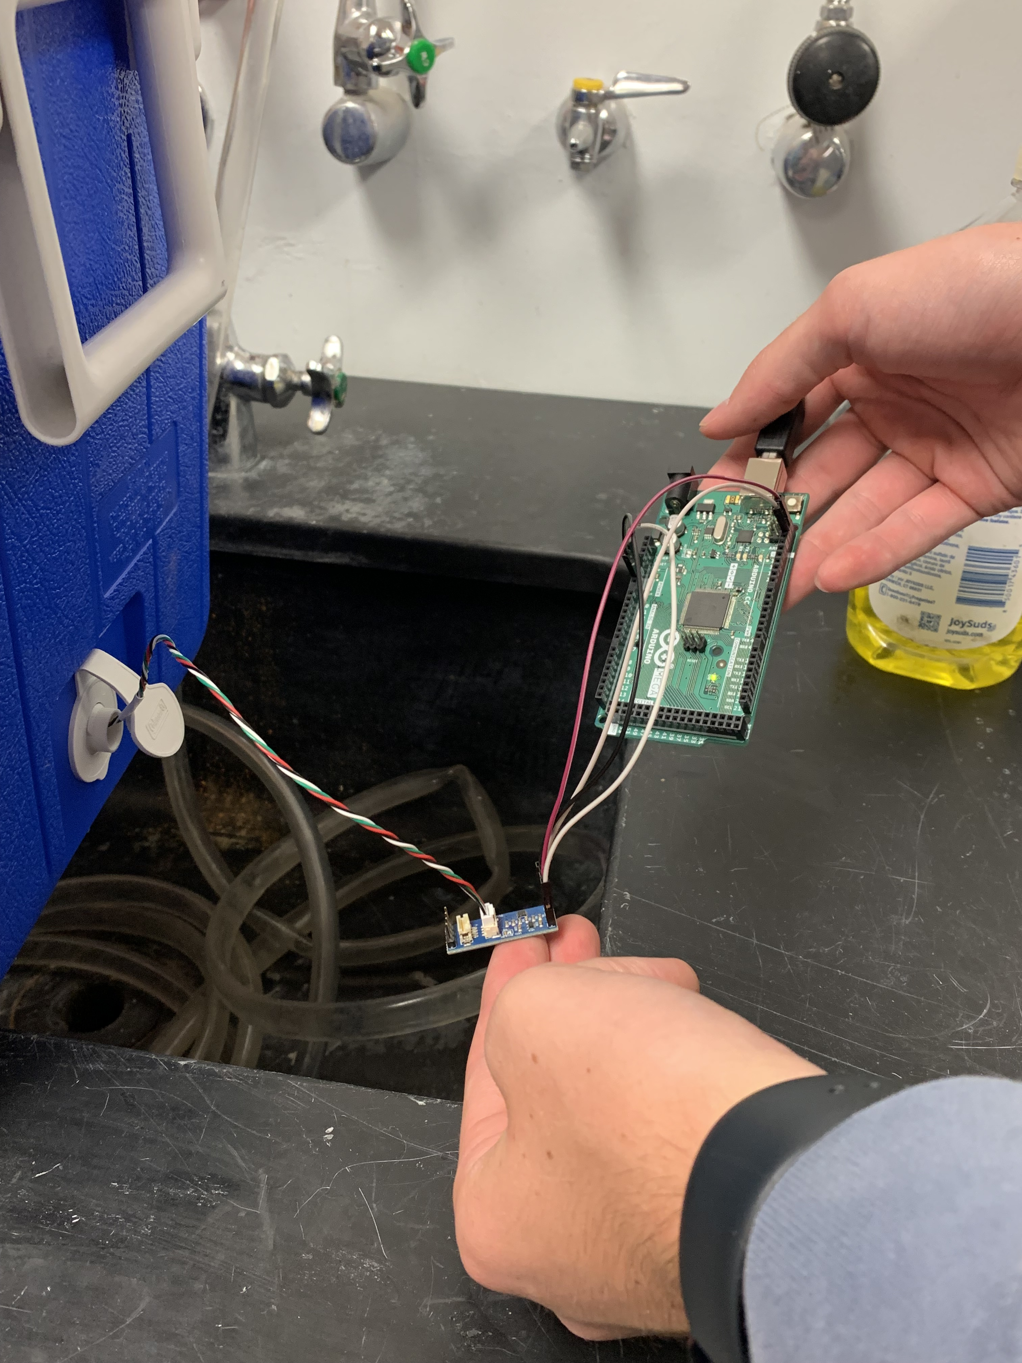
Barometer Testing
Megan Jadush
Arduino Mega 2560
Barometer
Level Converter

Slide 26
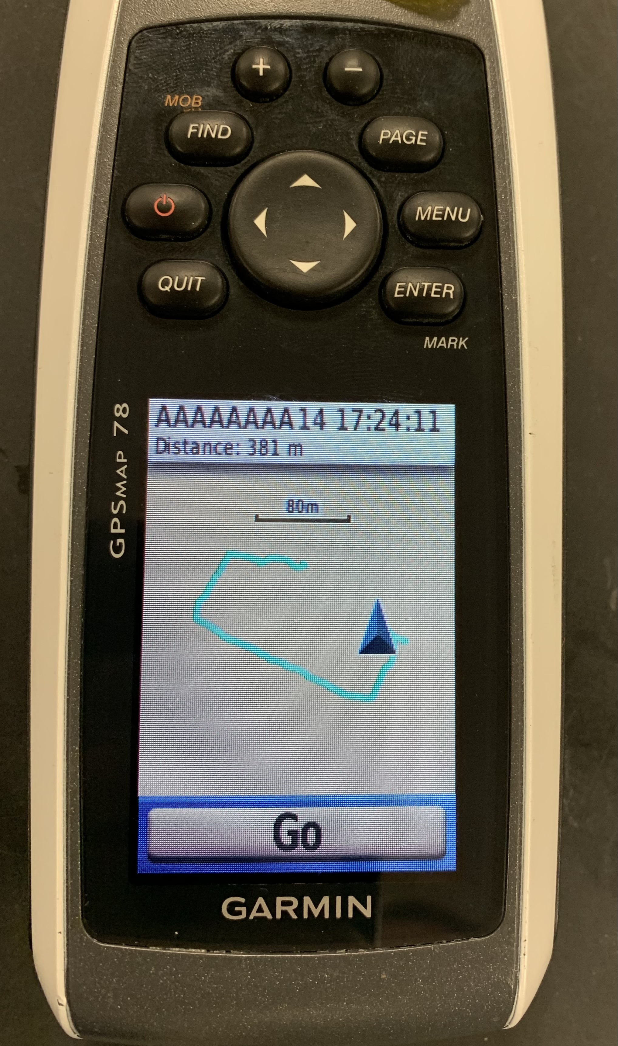
GPS and INS Testing
Megan Jadush
GPS
Portable Charger
Pelican Case
INS
Arduino

Slide 27
Angle Sensor Testing
Megan Jadush
Angle Sensor
Arduino Mega 2560

Slide 28
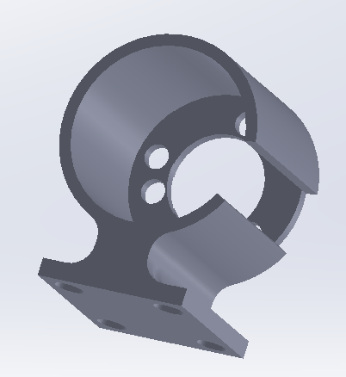
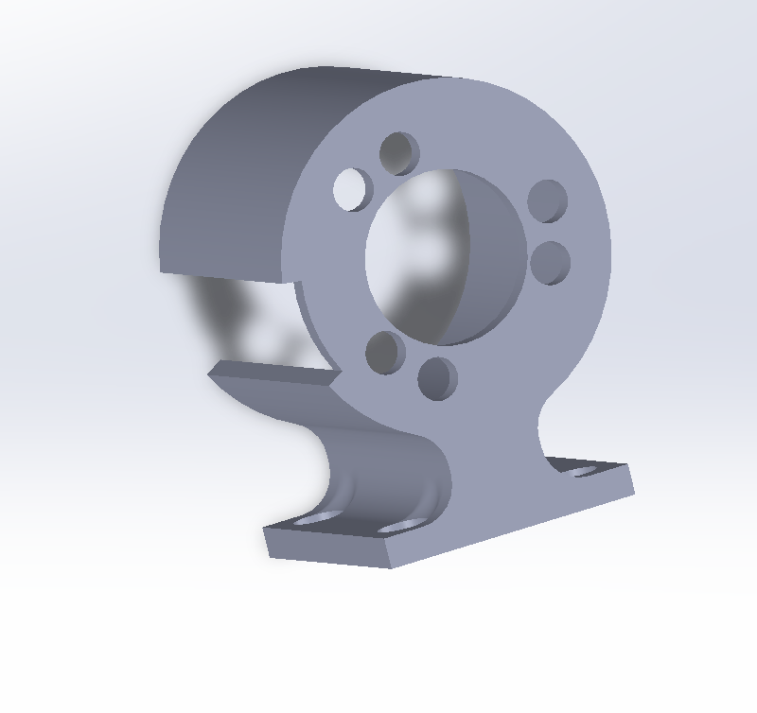
Angle Sensor Housing
Megan Jadush

Slide 29
Materials Moving Forward
Megan Jadush
Above Surface System

Slide 30
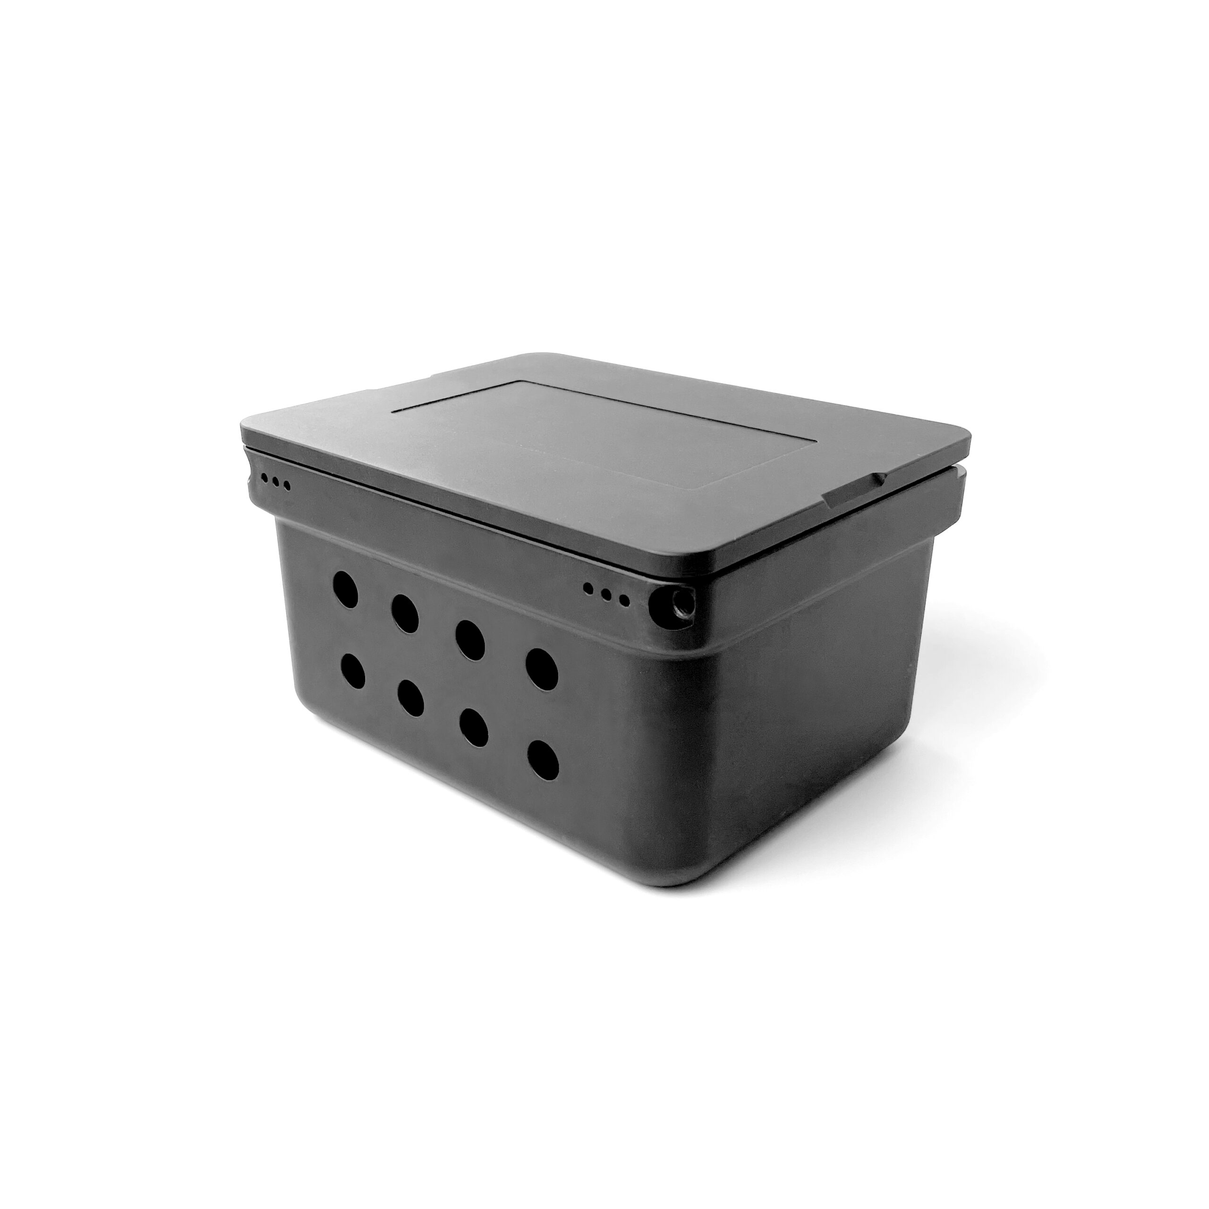
Megan Jadush
Materials Moving Forward
Below Surface System
Blue Robotics Watertight Box [5]

Slide 31
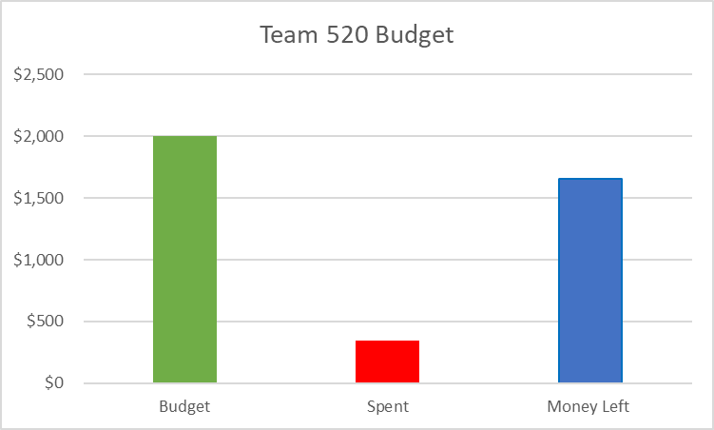
Project Budget
Megan Jadush
$1655
$345

Slide 32
References
Megan Jadush
[1] What is an Inertial Measurement Unit? (2024). VectorNav. https://www.vectornav.com/resources/detail/what-is-an-inertial-measurement-unit
[2] Garmin GPSMAP 78 Handheld Navigator - 010-00864-00. (2024). Marine Electronics Shop. https://www.marine-electronics-shop.com/garmin-gpsmap-78-handheld-navigator-010-00864-00/
[3] Bar02 Ultra High Resolution 10m Depth/Pressure Sensor. (n.d.). Blue Robotics. https://bluerobotics.com/store/sensors-cameras/sensors/bar02-sensor-r1-rp/
[4] SparkFun OpenLog Artemis - DEV-16832 - SparkFun Electronics. (2022, November 5). Sparkfun.com. https://www.sparkfun.com/products/16832
[5] Blue Robotics Watertight Box – Blue Robotics. (2024, April 30). BlueRobotics.com
https://bluerobotics.com/store/watertight-enclosures/watertight-boxes/watertight-box/

Slide 33
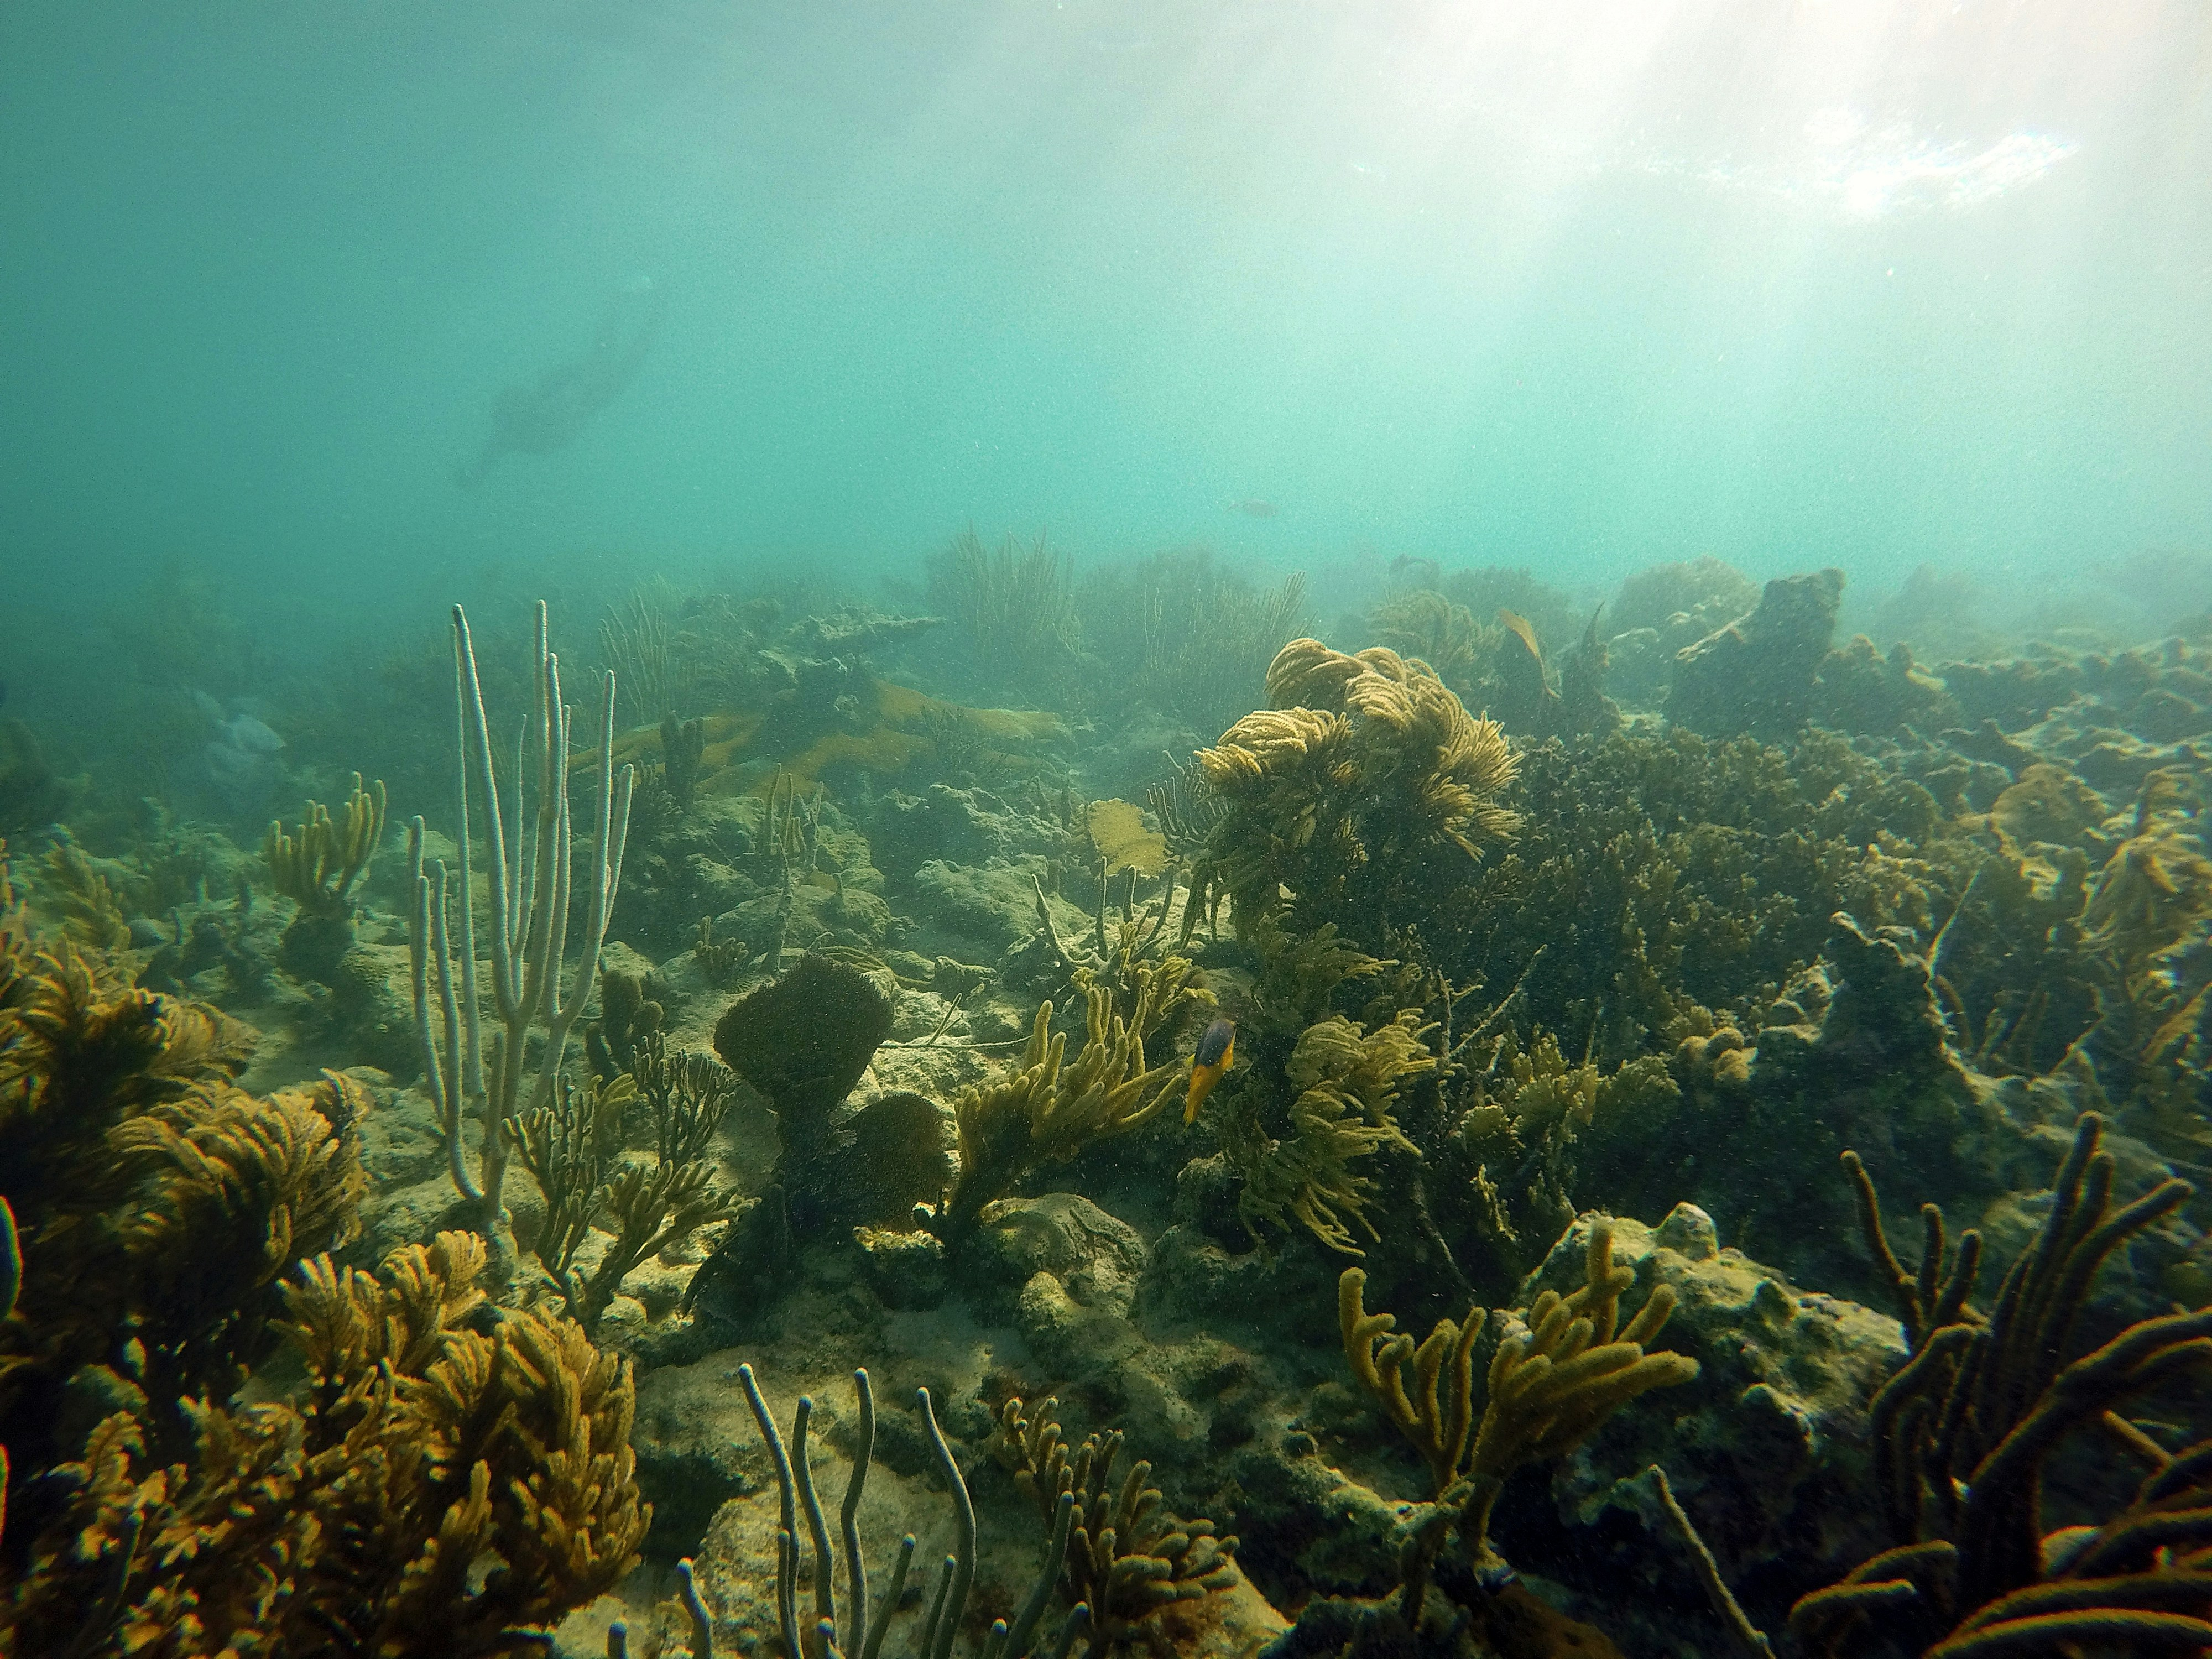
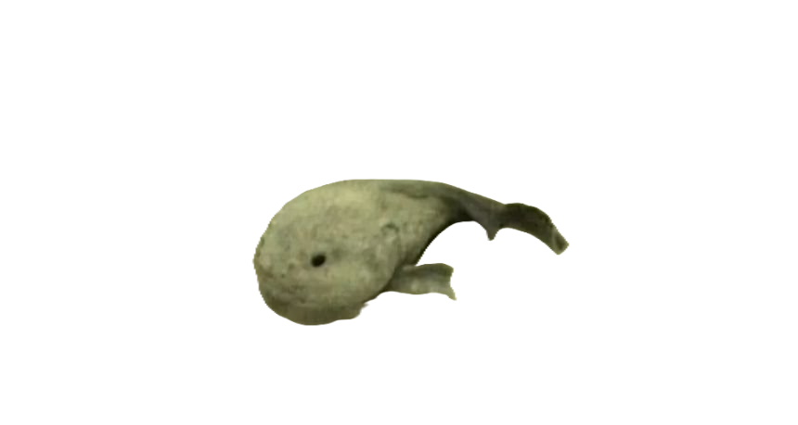
What This Is All For
Megan Jadush

Slide 34
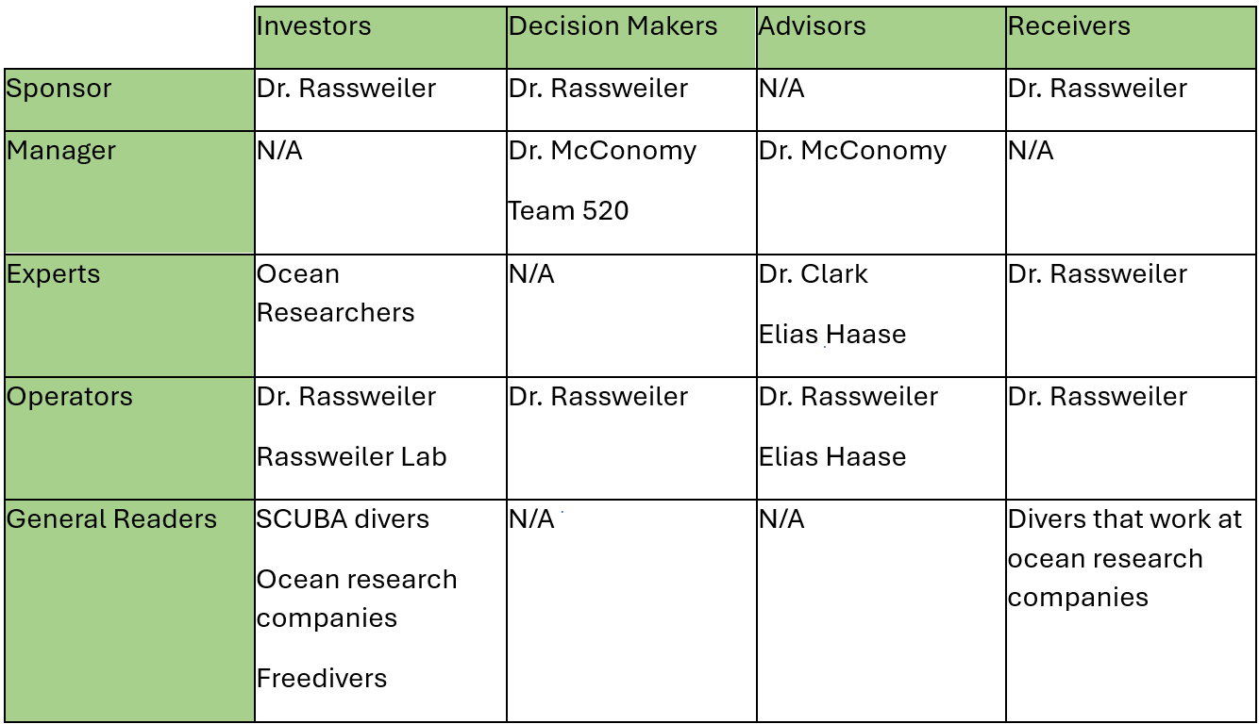
Stakeholder Matrix

Slide 35
Back Up Slides

Slide 37
Slide Headline
Try to keep text at 16 pt minimum.
Try to put as few words as possible on the slide if you’re using for a presentation.
Mix and match the backgrounds as shown in this template or just use one throughout.
You can put department/unit logos in slide master at Horizontal 0.89” Vertical 6.44” From top left corner

Slide 38
Font Check
This is 10-point
This is 15–point Times
This is 20–point
This is 25–point
This is 30–point
This is 35–point
This is 40–point
This is 50–point
This is 60–point
This is 72–point
Notes:
Use at least 20-point font in Room A105, B134, and B136
Use at least 25-point font in Room B135

Slide 39
College of Engineering Color Palette
1 2 3 4
Pantone: PMS 195 C
RGB: 120, 47, 64
Hex: #782F40
CMYK:19, 90, 50, 55
1 2 3 4
Pantone: Black C
RGB: 0, 0, 0
Hex: #000000
CMYK:0, 0, 0, 100
Garnet
Black
1 2 3 4
RGB: 238, 118, 36
Hex: #EE7624
CMYK:2, 66, 99, 0
1 2 3 4
Pantone: PMS 000C
RGB: 255, 255, 255
Hex: #FFFFFF
CMYK: 0, 0, 0, 0
Fang
Orange
White
Notes:
Avoid 75% Black in B135

Slide 40
Accent Color Palette
1 2 3 4
RGB: 0, 59, 111
Hex: #003B6F
CMYK:
1 2 3 4
RGB: 0, 59, 111
Hex: #003B6F
CMYK:
1 2 3 4
RGB: 251, 236, 93
Hex: #FBEC5D
CMYK:
1 2 3 4
RGB: 219, 215, 210
Hex: #DBD7D2
CMYK:
1 2 3 4
RGB: 251, 236, 93
Hex: #FBEC5D
CMYK:
1 2 3 4
RGB: 219, 215, 210
Hex: #DBD7D2
CMYK:
Tardis Blue
Tardis Blue
Corn
Timberwolf
Corn
Timberwolf
1 2 3 4
RGB: 206, 0, 88
Hex: #CE0058
CMYK: 0, 100, 43, 12
1 2 3 4
RGB: 206, 0, 88
Hex: #CE0058
CMYK: 0, 100, 43, 12
1 2 3 4
RGB: 104, 40, 96
Hex: #682860
CMYK:
1 2 3 4
RGB: 220, 220, 220
Hex: #DCDCDC
CMYK:
Rubine Red
Rubine Red
Imperial
Gainsboro
1 2 3 4
RGB: 72, 146, 155
Hex: #48929b
CMYK:
1 2 3 4
RGB: 64, 224, 208
Hex: #40E0D0
CMYK:
1 2 3 4
RGB: 255, 139, 0
Hex: #FF8B00
CMYK:
Asagi-iro
Turquoise
American Orange
Notes:
Remove American orange add hyperlink grey
Make corn the last for b135
All work in 134 imperial move later
Tardis doesn’t work in b136

Slide 41
F7AB19
D67F15
EE7624
D64615
F73119
Analogous
6E3610
F0A16C
EE7624
6E4931
BASB1C
Monochromatic
A14508
4BED3B
EE7624
250CED
2010A1
Triad
A1470C
FF8C40
EE7624
0098A1
24E2ED
Complementary
28A164
2FED8D
EE7624
0848A1
1871ED
Split Complementary
EDAC2F
3BED93
EE7624
0C6AED
ED2F18
Double Split Complementary
ED660C
C7ED3B
EE7624
0CE1ED
A418ED
Square
BA7E09
87724A
EE7624
60EFCF
09BA61
Compound
https://color.adobe.com/create/color-wheel
AD551A
6E3610
EE7624
FA7625
D46820
Shades
Notes:
These are the variants that work well with Fang Orange. The bolded items show well on the projectors.

Slide 42
85412D
8F3831
782f40
8F3176
792D85
Analogous
C44D69
8E626D
782F40
C48796
451B25
Monochromatic
C43959
78743B
782F40
236178
43A2C4
Triad
C43959
C46078
782F40
25C43D
2F783A
Complementary
93C460
577835
782F40
39C49D
297861
Split Complementary
784435
5A783B
782F40
237860
6E2978
Double Split Complementary
782337
78683b
782F40
237830
293978
Square
AB4D32
DEBAAF
782F40
5D8555
70AB32
Compound
https://color.adobe.com/create/color-wheel
38161E
C44D69
782F40
853447
5E2532
Shades

Slide 43
A105
A105
B135 Stage Left
B135 Stage Right
B136
B134, A105
B135

Slide 44
Border Line
Border Line
Border Line
Center of White Space
Center of Slide
Middle of Slide
Middle of White Space
Edge of Branding
Border Line
Notes:
Vertical lines from top down.
Borderline and top of title. (0.5 inch)
Center of Slide (0 inch y-direction for the entire slide)
Center of Design Content (0 inch y-direction considering the title, footer, and negative space)
Bottom of Design Content (0.25 in gap to the footer. 0.75 to the bottom of the screen)
Horizontal lines from left to right
Borderline (0.5 inch)
Center of design content.
Center of slide (0 inch y-direction for the entire slide)
Borderline (0.125 inch all around)

